Slide 1

Corporate Overview:
Non-Confidential
February 2024
quoinpharma.com

Slide 2
CAUTIONARY STATEMENT REGARDING
FORWARD-LOOKING STATEMENTS
This presentation contains forward-looking statements, which are based on our management’s current beliefs, expectations and assumptions about future events, conditions and results and on information currently available to us.
In some cases, you can identify forward-looking statements by terminology such as “anticipate,” “believe,” “could,” “estimate,” “expects,” “intend,” “may,” “plan,” “potential,” “predict,” “project,” “should,” “will,” “would” or the negative or plural of those terms, and similar expressions intended to identify statements about the future, although not all forward-looking statements contain these words. Any statements in this presentation about our expectations, beliefs, plans, objectives, assumptions or future events or performance are not historical facts and are forward-looking statements. These forward-looking statements include, but are not limited to, statements concerning the following: our product pipeline; anticipated regulatory filings; regulatory approvals and the timing thereof; plans for clinical trials and studies and the timing thereof; plans to develop and commercialize products and the highly attractive commercial opportunity.
These statements involve known and unknown risks, uncertainties and other factors that may cause our actual results, levels of activity, performance or achievements to be materially different from the information expressed or implied by these forward-looking statements. Such risks, uncertainties and other factors relate to, among other things: our ability to generate favorable pre-clinical and clinical trial results; our ability to identify and develop potential product candidates; additional costs or delays associated with unsuccessful clinical trials; the inability to predict the timing of revenue from sales of a future product; the extensive regulatory requirements and future developmental and regulatory challenges we will still face even if we obtain approval for a product candidate; our ability to obtain or maintain orphan drug designation or data exclusivity for our product candidates; our ability to obtain Orphan Disease and Rare Pediatric Disease designations for our product candidates; our manufacturing processes may not be validated and our methodology may not be accepted by the scientific community; and the ability to conduct clinical trials, because of difficulties enrolling patients or other reasons.
You should refer to “Risk Factors” in our Annual Report on Form 10-K for the fiscal year ended December 31, 2022 filed with the SEC on March 15, 2023, as updated by our subsequent filings with the SEC, for a discussion of these and other important factors that may cause our actual results to differ materially from those expressed or implied by our forward-looking statements. Given these risks, uncertainties and other factors, many of which are beyond our control, we cannot assure you that the forward-looking statements in this presentation will prove to be accurate, and you should not place undue reliance on these forward-looking statements. Furthermore, if our forward-looking statements prove to be inaccurate, the inaccuracy may be material. In light of the significant uncertainties in these forward-looking statements, you should not regard these statements as a representation or warranty by us or any other person that we will achieve our objectives and plans in any specified time frame, or at all. We qualify all of our forward-looking statements by these cautionary statements.
This presentation may contain market data and industry forecasts that were obtained from industry publications. These data involve a number of assumptions and limitations, and you are cautioned not to give undue weight to such estimates. While we believe the market position, market opportunity and market size information included in this presentation is generally reliable, such information is inherently imprecise.
Except as required by law, we assume no obligation to update these forward-looking statements publicly, or to revise any forward-looking statements to reflect events or developments occurring after the date of this presentation, even if new information becomes available in the future.

Slide 3









Investment Highlights
Experienced Management Team with proven track record of success
Differentiated polymer delivery technology with Strong IP Position
Establishing own sales infrastructure for both US and EU markets
Focused Rare and Orphan Disease product pipeline
Two Clinical trials underway under open IND in Netherton Syndrome
Nine Ex-US and EU Partnerships in place covering 61 countries
Rare Pediatric Designation opportunity for lead products
Targeting US/EU Approval in 2025
Started trading on NASDAQ (QNRX) October 29,2021. Fully funded through 2024

Slide 4
Product Pipeline
Product Candidate
Indication
Pre-Clinical
Phase 1
Phase 2
Phase 3
Approval
QRX003
Netherton Syndrome
Peeling Skin Syndrome
SAM Syndrome
Palmoplantar Keratoderma
QRX008
Scleroderma
QRX007
Netherton Syndrome
QRX004
Epidermolysis Bullosa

Slide 5

Netherton Syndrome
Devastating genetic disease
Form of Ichthyosis
Patients suffer from multiple severe issues:
Infections, allergies, asthma, skin cancer,
pruritis, warts
Can be hospitalized on multiple occasions annually
Environmental toxins, allergens and other micro-organisms can pass through virtually unhindered
Patients often need to coat their whole body with a moisturizer 5-6 times daily
3000 – 4000
Patients in US, similar number in Europe
1 in 200,000
Newborns affected
Daily Treatment
for the remainder of the patient’s life

Slide 6
New Treatments Needed
    Currently no cure for Netherton Syndrome and no approved treatments
Current options are limited to alleviating some symptoms:
    Moisturizers typically used for skin barrier repair, such as those containing lanolin and petrolatum, can cause further skin damage to NS patients due to friction or high shear forces on application or removal
    Topical steroids have been shown to further reduce skin thickness by up to 70% and have led to Cushing Syndrome
    Other topical treatments, such as calcineurin inhibitors, can lead to dangerously high systemic blood levels due to the defective skin barrier
    Systemic biologics can provide relief from pruritis but are expensive and not reimbursed
QRX003 on track to becoming first approved treatment for NS

Slide 7
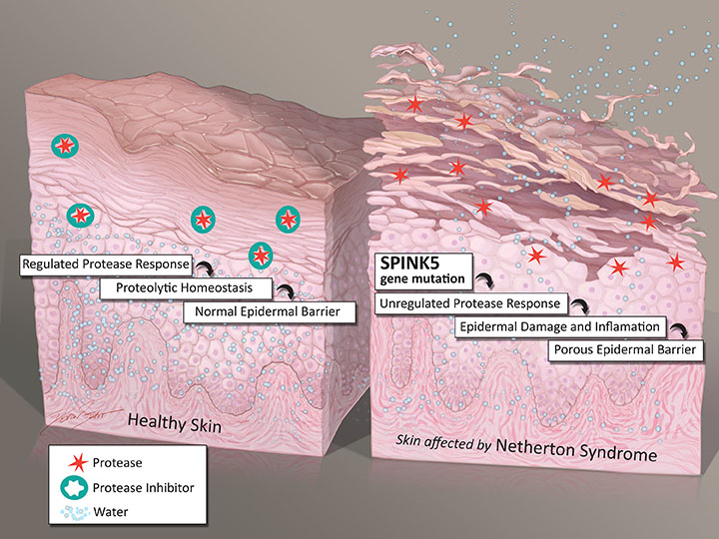
Netherton Syndrome (NS)
NS is caused by a mutation of the SPINK5
(serine protease inhibitor, Kazal Type 5) gene
SPINK5 mutations
LEKTI 1
Corneodesmosomes
Kallikreins
Antimicrobial
Infections
Peptides
Stratum corneum
cohesion
Lipid processing
enzymes
IL-1α activated
Thinning (loss) of
stratum corneum
Lamellar bilayers
Inflammation
Barrier Dysfunction

Slide 8


QRX003 Targets the Vicious Circle of Skin Inflammation and Barrier Disruption
    Broad Spectrum Serine Protease Inhibition Plus Anti-inflammatory Activity
Serine Protease Inhibitor/ Anti-inflammatory
Invisicare Delivery Technology
QRX003
Targets the KLK5, KLK7 and KLK14 kallikreins that are responsible for excess skin shedding
Potent anti-inflammatory
Adequately penetrates the skin but is not absorbed systemically
Immediate protection against TEWL and environmental agents
Moisturizes and protects skin
Patented polymer delivery system
Topical lotion
Active ingredient replaces missing LEKTI protein, enabling the skin barrier to be repaired. Moisturizes and protects skin.

Slide 9


Clinical and Regulatory Pathway
Clear Clinical Path Forward based on FDA Feedback
Approximately 20 Subjects may be sufficient for Approval
QRX003 Qualifies for One or More Expedited Approval Pathways
FDA Recommended Assessing 5 Different Endpoints, Including Composite Endpoints of Investigator and Patient Data
Lowered Requirements for Achieving a Successful Clinical Outcome
Positive Scientific Advice Received from EMA
Two Clinical Trials Underway in NS Patients
Targeting approval in US and EU in 2025

Slide 10
Clinical and Regulatory Pathway:
Study 1: Placebo Controlled
Single
Pivotal Trial
Part A
Completed
Part B to start Q1 24
All subjects must fully wash out of off-label systemic therapy prior to entry into study
Double blind 3 arm study in 8 adult NS subjects
Two doses of QRX003 being tested versus placebo
Test materials applied to pre-specified areas of body, once daily over 12-week period
Double blind 2 arm study in 22 NS subjects
Single dose of QRX003 versus placebo
Study will recruit both adult and pediatric subjects
Dosing frequency increased to twice daily

Slide 11
Clinical and Regulatory Pathway:
Study 2: Open Label
Part A Completed
Part B Starting Q1 24
Same Design as Study 1
All subjects must be currently treated with off-label systemic therapy
Subjects will remain on systemic therapy throughout 12-week study
Initially dosed once-daily
Single Arm Study in adult NS subjects
High dose of QRX003 being tested
No Placebo
Dosing frequency increased to twice daily and study size to 20 subjects
QRX003 being assessed as adjuvant therapy
Same sites, investigators and endpoints as Part B of Study 1
Positive results for first 6 subjects. Clean safety profile to-date.

Slide 12
Initial Open Label Data
Results from 6 subjects who have completed treatment to date
All subjects were dosed once-daily with 4% QRX003 in conjunction with off-label systemic therapy
Following clearance by FDA, going forward all subjects will be dosed twice-daily with 4% QRX003 in conjunction with off-label systemic therapy
Data presented for pruritis, IGA/M-IASI, PASA
Positive safety signals across both ongoing studies

Slide 13
Initial Open Label Data On Completion of Dosing
Pruritis:
  5 subjects reported absence of or negligible pruritis
  1 subject unchanged
IGA/M-IASI
  3 subjects demonstrated improvement on completion
  3 subjects showed improvement during study
PASA:
  Positive feedback across a number of metrics including: ease of use, time to start working, overall satisfaction, lack of side effects
*All data reported is change from baseline

Slide 14
Highly Attractive Commercial Opportunity
QRX003 is a ‘Whole Body, Whole Life’ Product
Small, compact sales force will effectively detail product in both US and EU
Estimated 6,000-7,000 patients in US and EU
Upside sales potential outside of US and EU. Nine partnerships established covering 61 countries. Potential to participate in Early Access programs ahead of regulatory approval

Slide 15
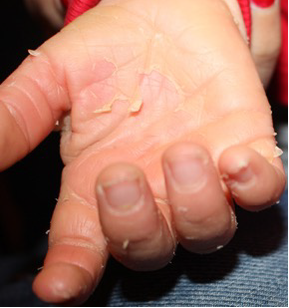
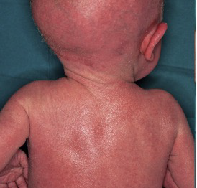
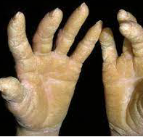
QRX003 For Additional Rare
Skin Disorders
Peeling Skin Syndrome
SAM
Syndrome
Palmoplantar
Keratoderma
<1/1000000
Caused by mutations in the TGM5 gene
Causes painless peeling of the top layer of skin
Most apparent on the hands and feet
Severe dermatitis, multiple allergies, and metabolic wasting (SAM)
4.4 cases per 100,000
Causes Thickening of the skin on the hands and feet
Can be acquired or inherited
Caused by mutations in the desmoglein 1 gene (DSG1)
Currently no approved treatments for these disorders. Initial clinical testing to commence in 2024.

Slide 16

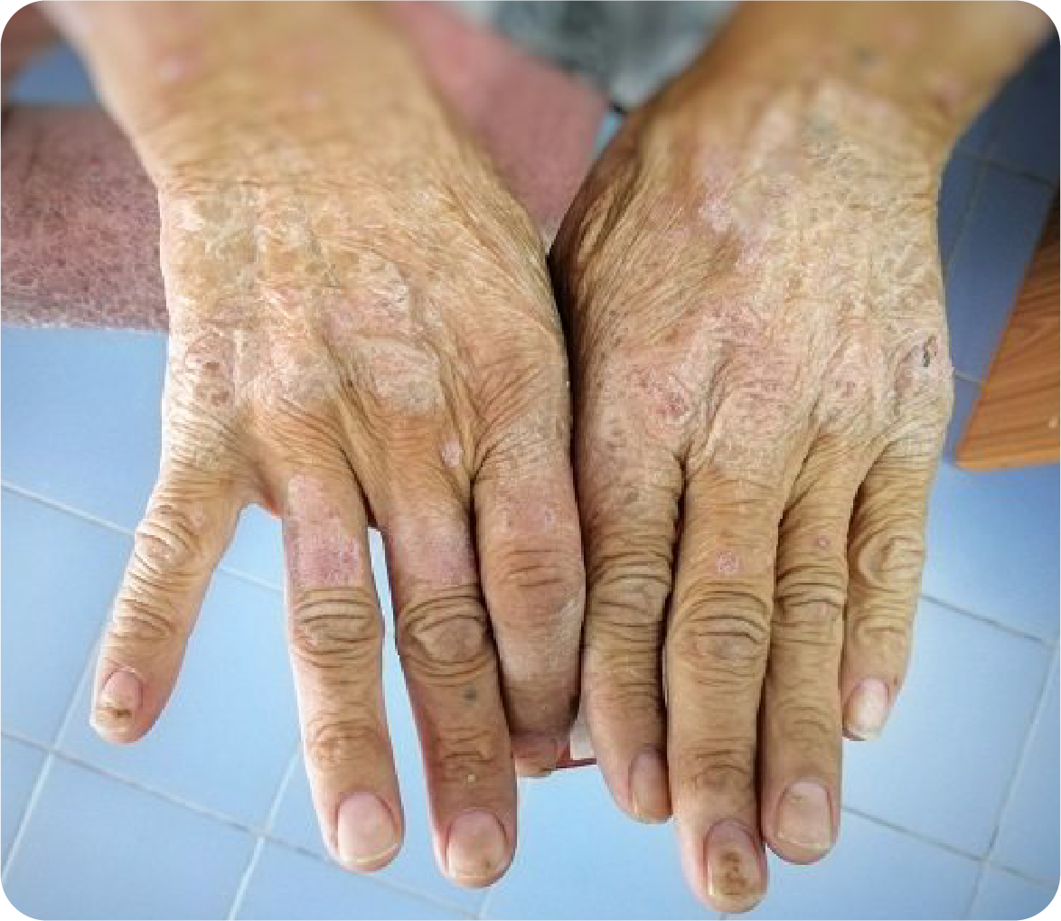
QRX008 for
Scleroderma
In-licensed from Queensland University of technology (QUT), Australia
No currently approved treatments for scleroderma, a rare and sometimes fatal autoimmune disease
Caused by over production of collagen which results in hardening of the skin and connective tissue
Focus is on investigating small molecule inhibition of the VCAM-1: VL-4 interaction
There is an established genetic and clinical link for VCAM1 in scleroderma and the pivotal role VL-4 plays in controlling immune cell migration into inflamed tissue
Therefore, the VCAM-1:VL-4 interaction is an attractive target for therapeutic intervention in scleroderma.
Proof of concept has already been established in a mouse model
Additional studies underway to select a candidate for clinical testing which will begin 1H 2024

Slide 17

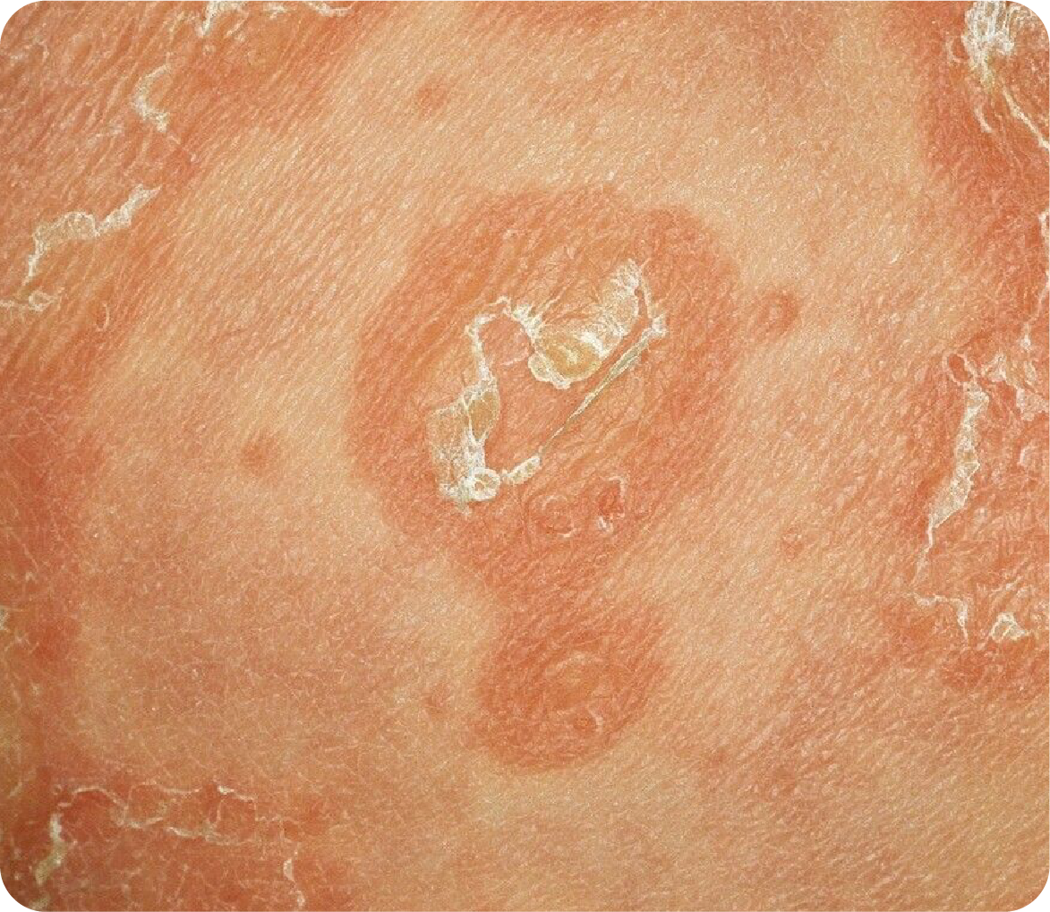
QRX007 for
Netherton
Syndrome
Also, in-licensed from QUT, Australia
Active is a dual domain serine protease inhibitor with proven anti inflammatory-activity
Already in use as a biopharmaceutical (Ulinastatin, Miraclid) for treatment of acute and chronic pancreatitis, Sepsis and toxic epidermal necrolysis
Active has achieved low nanomolar inhibitory potencies against the KLK7 and KLK5 kallikreins
Drug is a human protein and so is highly unlikely to provoke an immune response
Pre-clinical program underway at QUT
Quoin has global rights in return for a mid-single digit royalty on future sales

Slide 18
QRX004 For Recessive Dystrophic
Epidermolysis Bullosa (RDEB)
RDEB is a monogenic disease resulting in chronic skin blistering and wounding
High mortality rate – 76% of RDEB patients do not live beyond their 30’s
Current treatments only address symptoms
Cause: A mutation in the COL7A1 gene that encodes for COL7 Devastating, progressive, painful blistering disease that often leads to death
Bandaging alone can exceed $10,000 per month
Diagnosed at infancy
RDEB ~1,500 – 2,500 patients in US

Slide 19



Clinical and Regulatory Overview
Positive FDA guidance received from Pre-IND filing
Program on hold, pending review of market opportunity
Proof of Concept
28 day, 6-8 patient study in US
Patients act as
internal controls
Primary endpoint is proportion of wounds with greater than 50% healing for patients who receive QRX004 vs placebo vehicle
Registration
15-20 patient study with same design as Phase 2 study
Clear precedence for this approach based on competitors experience

Slide 20


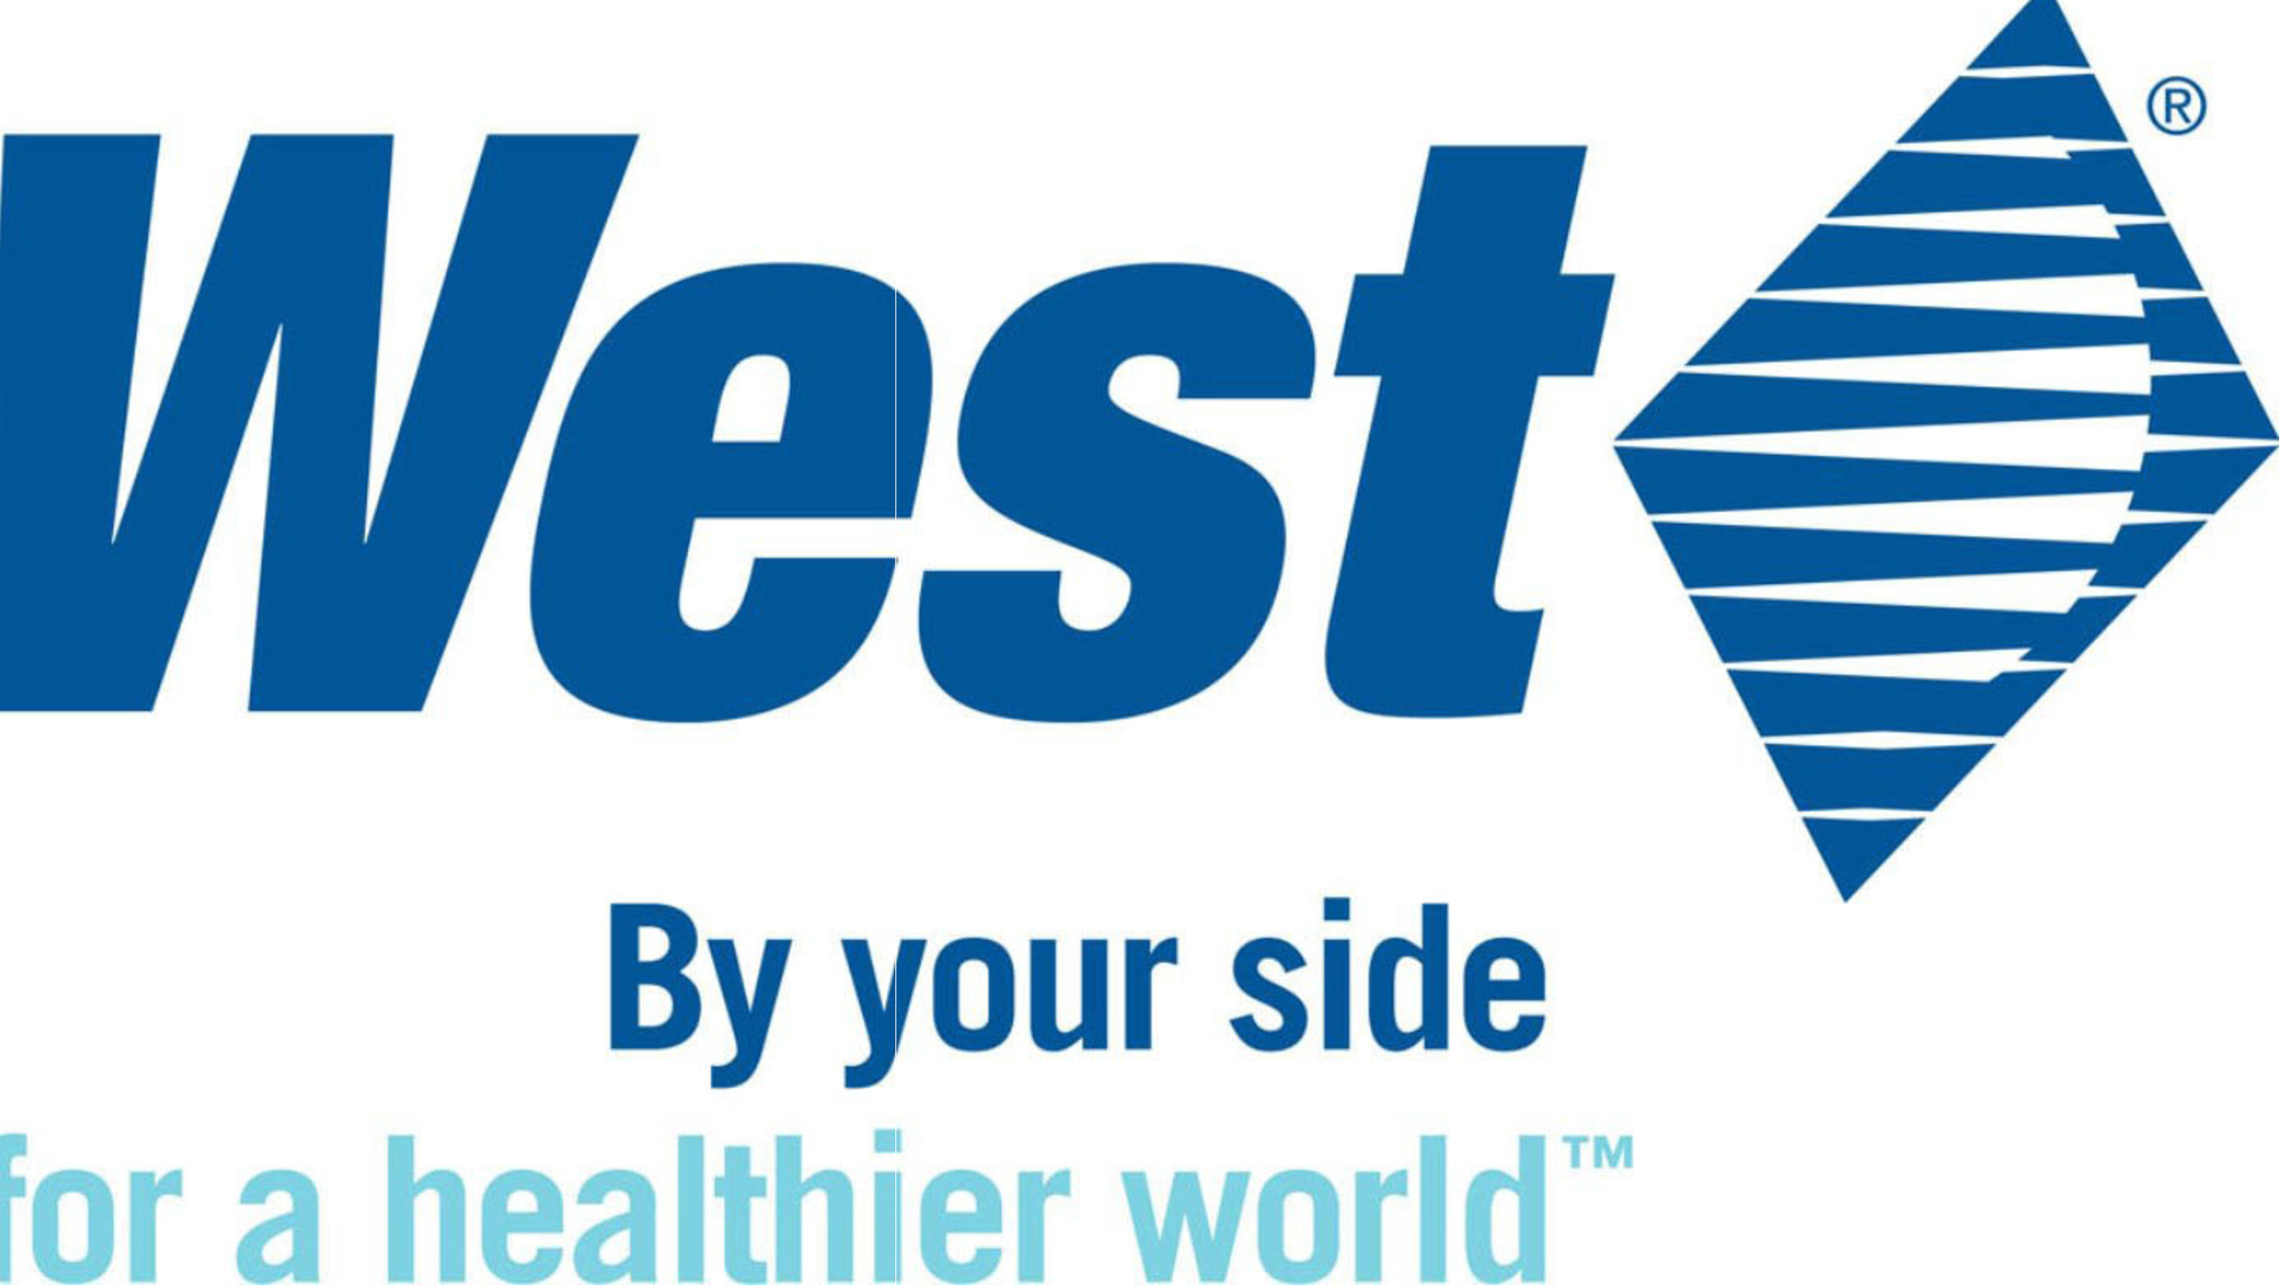









Strong Management Team with Proven Track Record of Success
Name
Position
Experience
Dr. Michael Myers
CEO
Denise Carter
COO
Gordon Dunn
CFO
Seasoned executives with over 80 years experience developing products based on drug delivery technologies
Proven track record transitioning companies to key inflection points, including mergers, reverse mergers acquisitions and IPOs
Raised over $250M in private and public markets.
Deep commercialization experience in US and Europe

Slide 21
THANK
YOU
quoinpharma.com

